Slide 1




Introduction to Qualitative Analysis Projects in Nvivo Katy Keenan, Dr Alasdair Stewart , Dalia Avello Vega, with material from Dr Kathryn Fredricks
Notes:
Introductions – who you are, which institution you're from, role in SGSSS

Slide 2
The aims of this workshop
AM
Setting up a project
Coding/
going further
Introduce you to how to use Nvivo projects for managing data and organizing your PhD project
How to use Nvivo for coding
Aimed at those who are complete beginners or who have limited exposure
PM

Slide 3
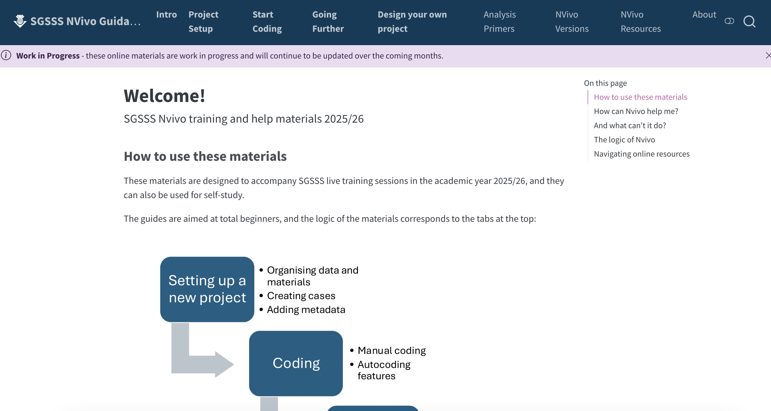
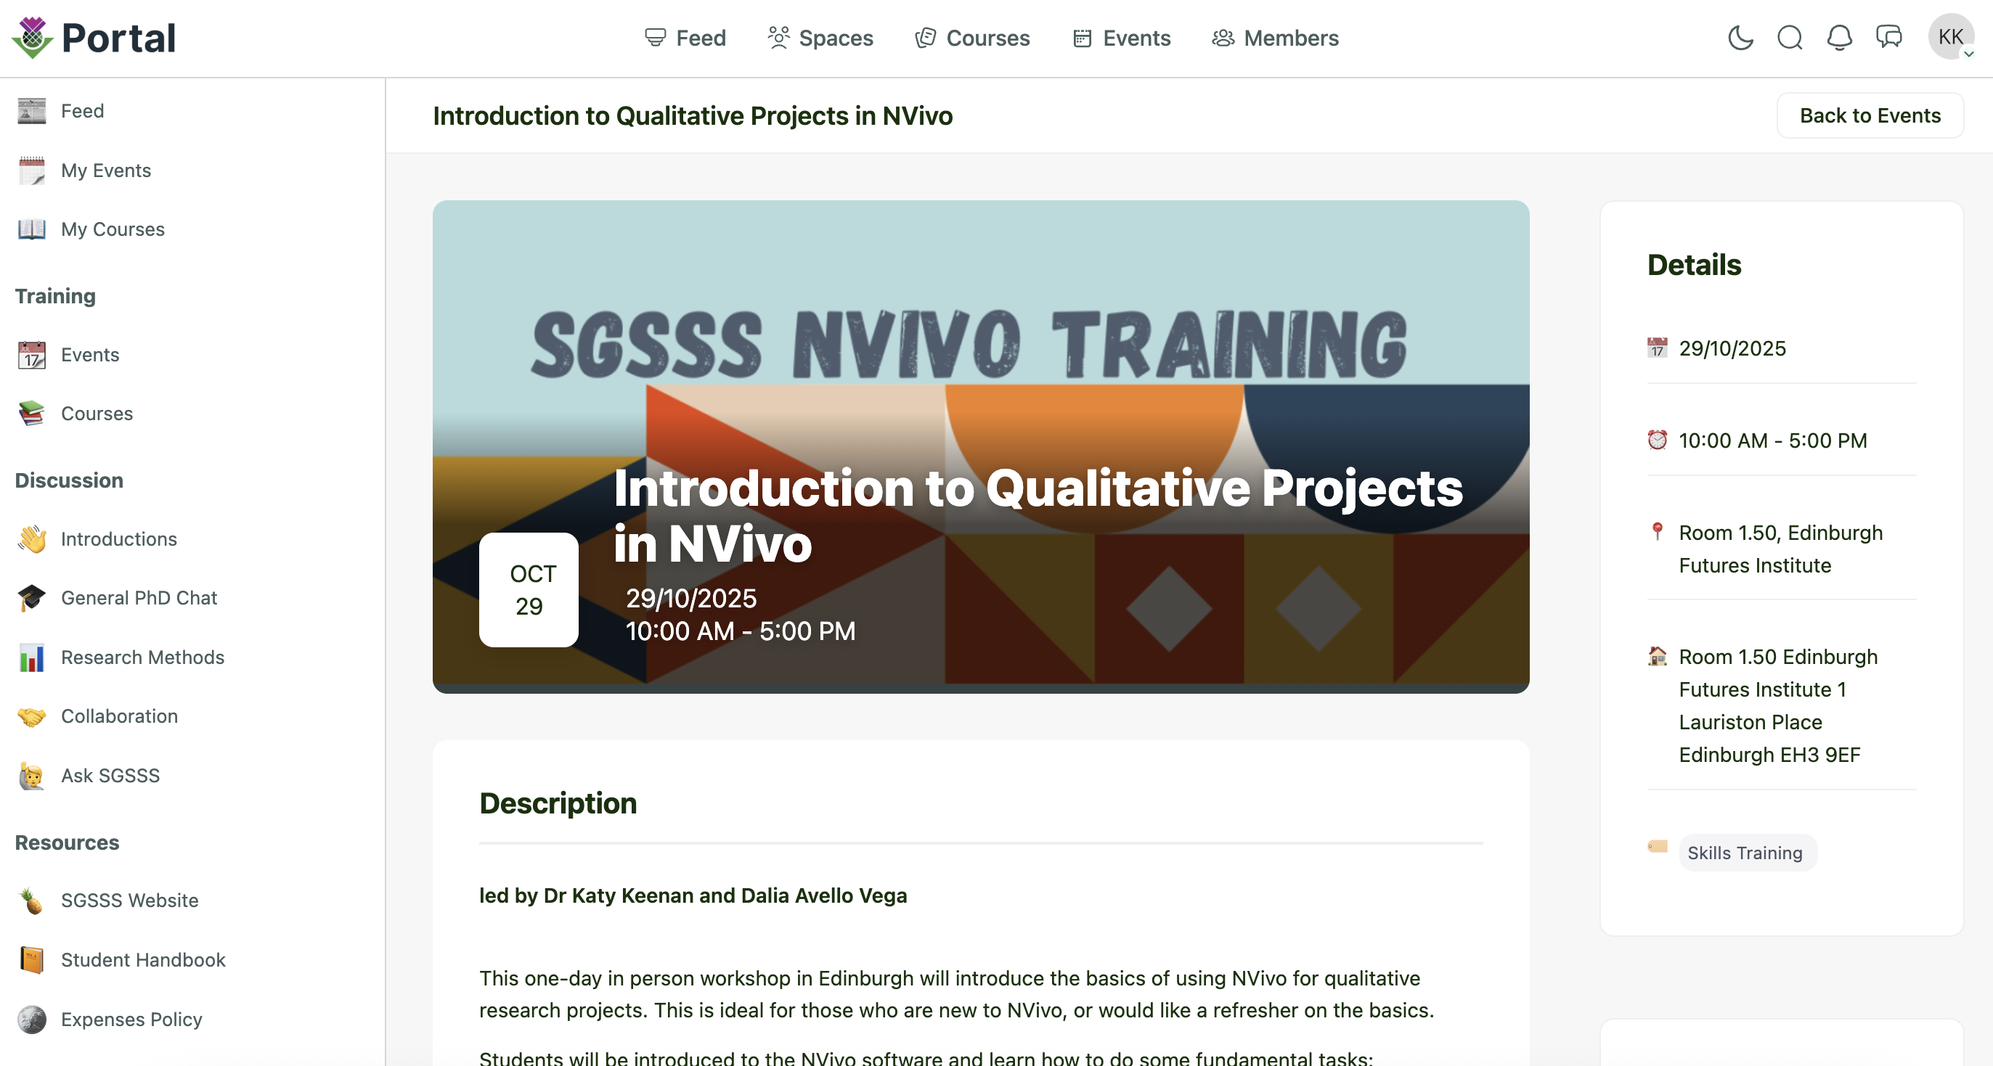
Workshop Materials
Access full walk through for the session here:
https://sgsssonline.github.io/nvivo-guidance/
Data files can be downloaded from link in the email sent
\

Slide 4
Over to you
What kinds of qualitative or quantitative research or mixed methods research are you conducting? What do you want to use Nvivo for?
Have you used any other Computer Assisted Qualitative Data Analysis Software If so, which one/s? Transana, atlas.ti, MAXQDA?

Slide 5
How can CAQDAS / Nvivo help you in your PhD?
Does not automatically make the research better; meaning-making (data analysis) can’t be computerised and made routine, this still depends on analysis abilities of the researcher
Objectivity and clarity are not related to software packages
Requires investment to set up a project; for smaller or more simpler analysis projects, may not be worth it
Suitability for some forms of qualitative analysis …. (e.g. IPA) worth discussing
Overall project and data management
Complex coding
Robustness and rigour: Can check coding by date/researcher
Can facilitate collaboration
Can saves time and less room for human error
Can visualise the data, see links and understand the data better

Slide 6
PART 1: Navigating Nvivo

Slide 7
Nvivo versions and compatibility The annoying parts
Release version | Key things to note /new features
Nvivo 12 (2018) Windows – Pro and Plus versions Mac (one version) | Pro- more advanced version allows many different file types (video, audio etc), has matrix coding
Nvivo Release 1.0 / AKA Nvivo 13 (2020) Windows Mac (more limited functionality)
Nvivo 14 (2023) Windows/mac versions
Nvivo 15 (2024) Window/mac versions | Includes ‘advanced AI assistant’
Forwards compatability
Differences in user interface- menu options- and naming conventions (see cheatsheet)

Slide 8
NVivo Guides
Windows
NVivo 12: https://help-nv.qsrinternational.com/12/win/v12.1.115-d3ea61/Content/welcome.htm
Release 1: https://help-nv.qsrinternational.com/20/win/Content/welcome.htm
NVivo 14: https://help-nv.qsrinternational.com/14/win/Content/welcome.htm
Nvivo 15: https://help-nv.qsrinternational.com/15/win/Content/welcome.htm
Mac
NVivo 12: https://help-nv.qsrinternational.com/12/mac/v12.1.115-d3ea61/Content/welcome.htm
Release 1: https://help-nv.qsrinternational.com/20/mac/Content/welcome.htm#
NVivo 14: https://help-nv.qsrinternational.com/14/mac/Content/welcome.htm
Nvivo 15: https://help-nv.qsrinternational.com/15/mac/Content/welcome.htm

Slide 9
Tour of Nvivo using the sample project

Slide 10
Data
What kind of files /data ?
Units of analysis
What units of analysis do I have?
Analysis themes
Key themes related to the research questions
Linkages
How are data and units connected?
Characteristics (metadata?)

Slide 11
Part 2: Dataset

Slide 12



Qualitative Election Study of Britain
Unique longitudinal qualitative election study : https://qesb.info/
Consists of focus groups and interviews conducted in 2010, 2014, 2015, 2016 and 2017
Data are open access and in reusable formats- making them perfect example of open science
Ideal for our purposes of practising qualitative data organisation and coding in NVivo
***Please sign your name on the permissions sheet circulating***

Slide 13


3 x focus groups with voters in different UK regions
15 x 1-2-1 telephone interviews with voters
X X X X X X X X
Some of the people in the focus groups have 1-2-1 interviews a year later
April 2015 July-August 2016
May 2015 UK General Election
June 2015 EU ‘Brexit’ referendum

Slide 14
2016 telephone interviews 7 questions that were sent in advance
What were your views on #Brexit (the UK leaving the EU) in the lead up to the election?
What do you think were the main messages of the Leave (Vote Leave) campaign? How would you rate that campaign?
What do you think were the main messages of the Remain (Stronger IN) campaign? How would you rate that campaign?
Did you vote and why? / If you didn’t vote, why was that?
How did you feel when you learned of the result?
What are your thoughts and reactions to Brexit?
Are you optimistic, pessimistic or uncertain about the UK’s future outside of Europe?

Slide 15
PART 2: Setting up a new project

Slide 16
Many ways to do a single task
How to import files:
From Ribbon: Import > files > select file
Drag and drop in from windows to the ‘files’ section
Right click under file menu
How to code:
From Ribbon: Create > code > new code
Right click under ‘code’ tab, create new code
Use coding bar to create new code over highlighted text
Drag and drop text
Notes:
Signal that in the step-by-step guide will walk through different ways of doing it – feel free to try them all, or just stick with the one that seems fastest and easiest for you
NOTE: as we import files, we have the option of creating ‘cases’ for the files we upload – we will do this for SOME of the files (individual interviews) as they are only one person, but not for all of them (e.g. lit, project files, and FGDs don’t map on to our ‘cases’ of people)

Slide 17

Organizing files and folders
Create a system that make sense for YOU
You can adjust it later
‘project files’ or ‘research tools’ can be stored as files OR memos
For me – where I ‘store’ information vs ‘think with’ it
Using ‘memos’ as a space to keep track of how you’re doing things
Prepare for writing up
Notes:
There are no rules on how best to organize your folders. The number, type and level of sub-folders is only limited by what seems useful to you, the researcher. For example, you could develop a folder category for ‘Published literature’. Such material (e.g. PDFs) can also be brought into NVivo and coded alongside your own field data. You could create a top-level ‘folder’ called ‘Literature’ and divide that with sub-folders for academic papers, traditional media (newspaper articles and other formal media), social media and for policy documents, etc. You could further divide these folders (i.e. ‘Academic papers’ with sub-folders like ‘theory’, ‘sustainability’, ‘community’ etc.) but these may be unnecessary as this can also be done with coding. Another useful top-level sub-folder might be ‘research tools’ and within that we could list interview schedule, focus group questions, etc.
Remember that you will be able to link all your files through to cases (grouping them by individual people or places). As you begin to set up a new project, take a few minutes creating some new sub-folders based on what you want to do within NVivo. Think about ‘good housekeeping’, clear naming and logical folder hierarchies.

Slide 18
Part 3: Coding

Slide 19
Getting on with coding
Codes are tags or containers for compiling information that is related – and from which related information can be retrieved later. Codes are a unit we use to organize our analysis. They are not the ‘answer’, they are a way to index, sort, link and interrogate data.
Deductive vs inductive coding
Iterative coding
Auto-coding?
Notes:
Iterative coding
Sorry folks, qualitative coding is far from one-and-done. Coding is a cyclical, ongoing process. Interviews cannot be read and coded just once. As we re-read our datasets, we continue to develop new codes and subcodes, and refine our understanding of the data. Each time we read our material, we gain a deeper level of understanding each time we read our transcripts. With each pass, we will notice new things, which may prompt us to read new academic articles or ask different questions. This work will in turn shape what we see and understand in our next reading of the dataset.
NVivo is a powerful tool to help us find and explore the connections to be found within our qualitative data, but ultimately finding those connections is down to the researcher. While in NVivo you can ‘auto code’, I hesitate to recommend this and would actively advise against auto coding until you’ve done at least 2-3 rounds of coding already.
Deductive vs Inductive Coding
In deductive coding, you approach your dataset with a pre-established list of codes (based off existing theoretical frameworks or organizational element). This is a more top-down, etic approach that is most useful for confirming or testing existing theories, or imposing organizational and structure into your file (e.g. coding by interview guide or research questions). Conversely, inductive coding occurs when you allow codes to emerge from your engagement with the dataset itself, with no preconceived categories. This is a bottom up, emic approach to coding. Your own approach may be heavily influenced by your discipline, research aims, and research questions. However, most work will be situated in a hybrid space between the two.

Slide 20
Coding
Remember when coding in Nvivo:
Codes can overlap
Codes will sort themselves to be alphabetical – clear, direct, short codes are helpful (you can expand in the description)
When creating a new code, always include a description of what you think this code means and what should be included here
Codes should change as your project changes. They can be combined and rearranged. Don’t be afraid to make a code because you’re not certain if it will be relevant or important enough. They’re a tool to think with
Be careful if coding when tired, bored, or distracted – you must always be actively thinking (the ‘organic computer’ [your brain] is the primary tool of analysis).

Slide 21
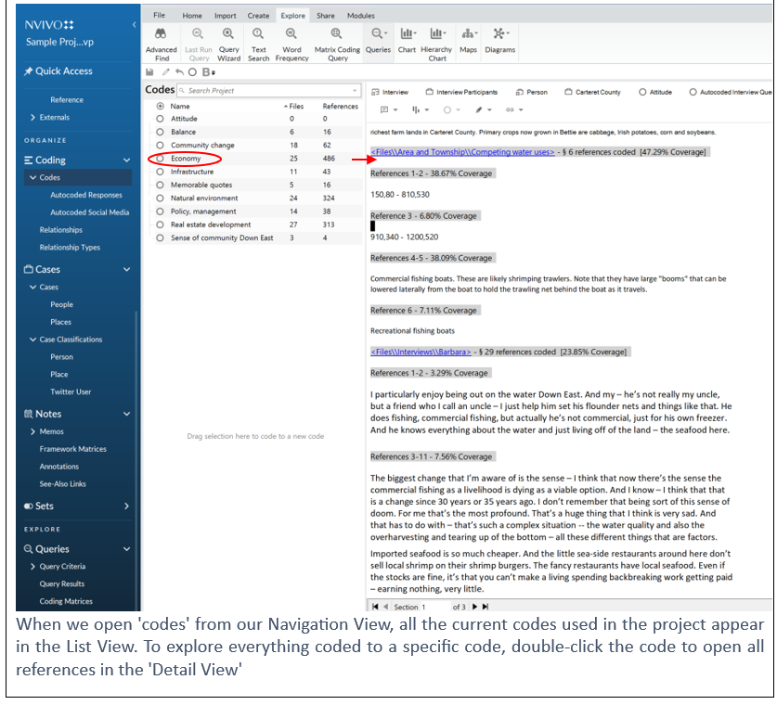

Slide 22
Coding Hierarchies
Some questions to reflect on:
Do any codes refer to a theme or idea that may be experienced in a number of different ways (different sources, targets, circumstances, etc.)?
Are there any common categories that would be useful to think with across many codes and examples?
Do some of your codes exist within a common theme that could become a parent code?
- Does it make sense to nest down, or create a new top code?
Does it make sense to nest down, or create a new top code?
Notes:
A powerful form of coding is hierarchical tree coding. Generally, this format will emerge after initial open coding. We usually do not begin our coding by creating hierarchies/trees. Instead, between coding rounds you should reflect on your codes and the relationships between them.
Some questions to reflect on with examples below:
Do any codes refer to a theme or idea that may be experienced in a number of different ways (different sources, targets, circumstances, etc.)?
Are there any common categories that would be useful to think with across many codes and examples?
Do some of your codes exist within a common theme that could become a parent code?

Slide 23
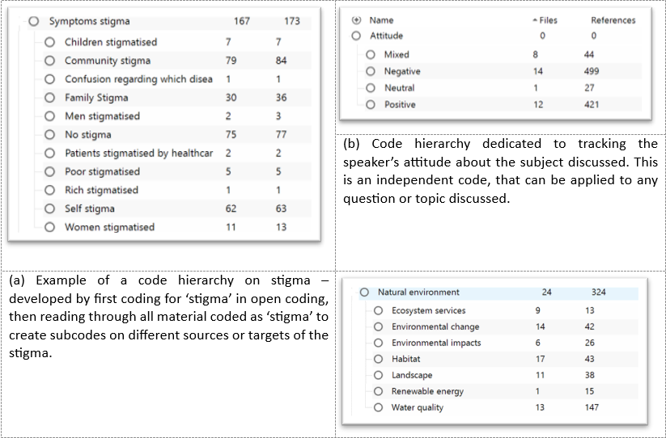
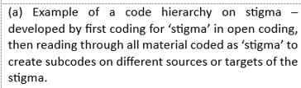

Notes:
AFTER THIS SLIDE – pull up NVivo project and open codes → group brainstorm to look at the existing codes ->
--can some be merged?
--are some related under a shared heading we can add?
--are some good candidates to be a top code that we dig into deeper in the next step?

Slide 24
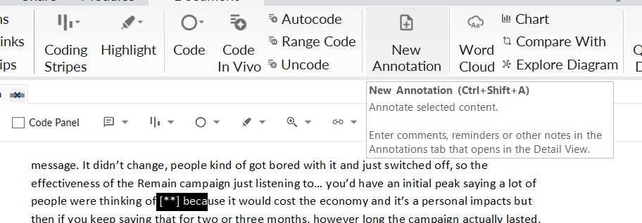
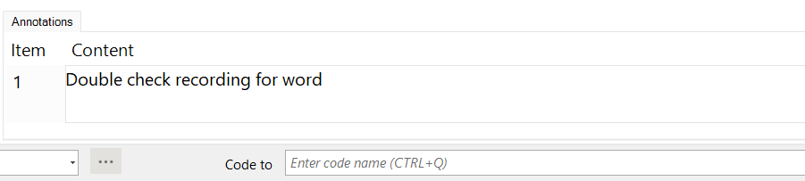
Extra Tips: Annotations
‘sticky notes’ you can attach to a file
Thoughts for yourself, questions to explore, possible link to literature
Notes:
Right click -> new annotation
Or small text bubble on the edit panel
Annotations act like sticky-notes that you can affix to a file to record thoughts, reflections, or questions (much like adding a comment to a Word document or PDF). Annotated sections will be highlighted and text recorded in an annotation tab at the bottom of the page.

Slide 25
Working with Memos
How will you approach your coding?
Research questions – what are areas you know you want to focus on
What are your codes?
Keep a running list, inc. logic of the code as you made it (did you start adding something at a certain point that wasn’t ‘in’ that code before?)
Do all codes apply to all interviews/files?
Are you running queries?
Keep a list of the queries you’ve run, etc.
Fieldnotes, reflections on readings, frustrations with the dataset
You can code your memos, and link to your transcripts
Notes:
Memos are separate pages you can create to record the ideas, insights, interpretations/understandings of the material in your project. They provide a way to keep your analysis separate from (but linked to) the material you are analysing.
Memos are a space for you to record the ideas, insights, interpretations/understandings of the material in your project. You can organize you ‘memos’ section much the way you organize your files – creating different folders and subfolders and populating them with relevant files. The main difference between this space and your ‘files’ space above is that ‘memos’ provide a way to keep your analysis separate from (but linked to) the material you are analysing. Memos are a space for you to talk to yourself as a researcher and work though ideas, next steps, and overviews. They can be an important element of analysis and writing-up. They can also be coded.
Some ideas on how to use memos:
Project-oriented Memos. Some good examples would be
‘Project aims and objectives’ (so these are always uppermost in our minds)
A ‘coding journal’ (to keep track of where codes come from – ‘emic’ or ‘etic’ – who developed them and what was agreed about how they would be used)
A ‘query log’ keeping track searches and queries you’ve run (both saved and unsaved)
A folder on fieldnotes and observations. For example, ethnographic observations while collecting data or meetings and events related to your data-collection or interlocutors.
A folder for academic reflections on events (workshops, lectures, conferences) related to your project or meetings with your supervisor(s).
Memos on individual files (e.g. a transcript). These could be fieldnotes about the interview itself and how data was collected in the field – or could be analytical comments to help our thinking and the production of reports.
Memos on codes. These could be notes about a code and how it was created and/or analytical ideas emerging from that coding and the material it gathers together.
TIPS FOR MEMOS:
You can either ‘import’ memos or create them within NVivo. It’s good practice to time/date stamp your memos to help you keep control of ideas and audit when they arose: when in the memo – press ‘Ctrl’ ‘shift’ then ‘T’ (for time). Later, you can easily ‘export’ memos and incorporate them into presentations or reports.
You can link from your memo directly to other content within your NVivo project by right clicking and selecting ‘Links’ > ‘See-Also Links’ > ‘New See-Also Link’
If you want to make changes inside of text files (memos – interviews), you need to toggle on the ‘edit’ feature within the detail view toolbar.

Slide 26
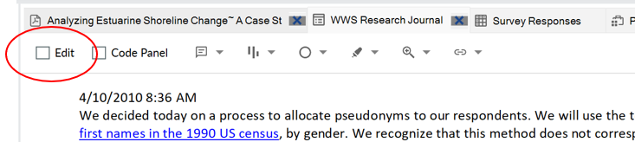
Tips for memos:
You can either ‘import’ memos or create them within NVivo. It’s good practice to time/date stamp your memos
Ctrl + shift + T → Timestamp
You can link your memo directly to other content within your project
Right clicking > Links > See-Also Links > New See-Also Link
If you want to make changes inside of text files (memos – interviews), you need to toggle on the ‘edit’ feature within the detail view toolbar.

Slide 27
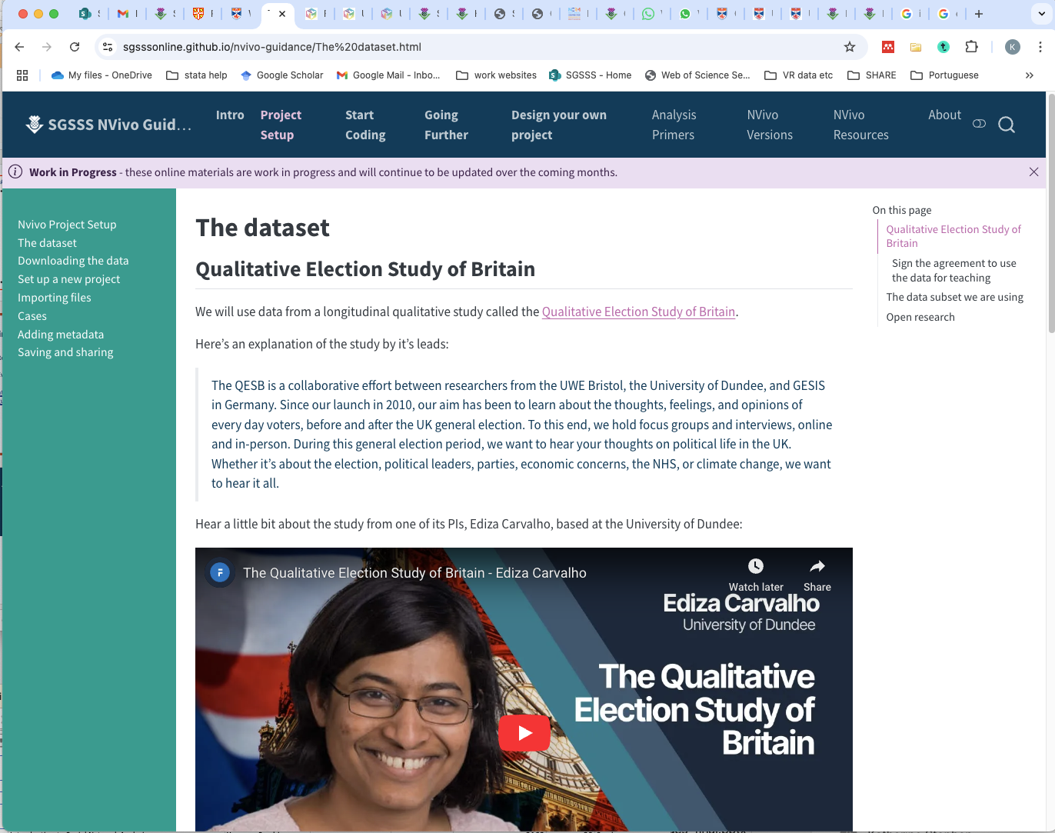
Final mentions
Resources file on Nvivo: especially Bazeley online materials
Evolving set of open access materials:
https://sgsssonline.github.io/nvivo-guidance/Getting%20started.html

Slide 28
Thank you to
Alasdair Stewart
Kathryn Fredricks
Rachel Shanks
For help developing material and feedback
https://sgsssonline.github.io/nvivo-guidance/

